Slide 1
Outline
Introduction
Explores spatial relations between ROIs in End-to-end model
The graph transformer model combines the learnable position encoding with graph structure to boost the performance
Get better interpretability with attention heatmap combining non-convex ℓ2,1−2 and ℓ1−2 regularization terms
(optional) multimodal learning
(optional) graph learning

Slide 2
Method
Message Passing Graph Neural network
Gated Graph transformer: counter the limitations of long-range interactions of the former
Regularization terms
Visualization

Slide 3
Experiments
Dataset
PNC: CNB scores prediction task
Ukbiobank (optional)
HCP

Slide 4
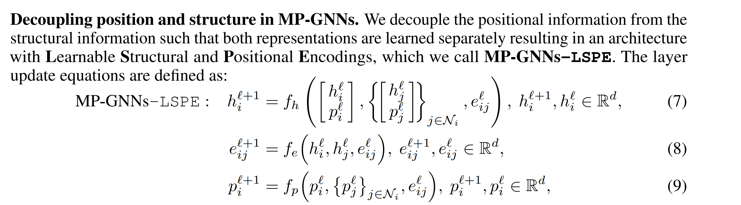
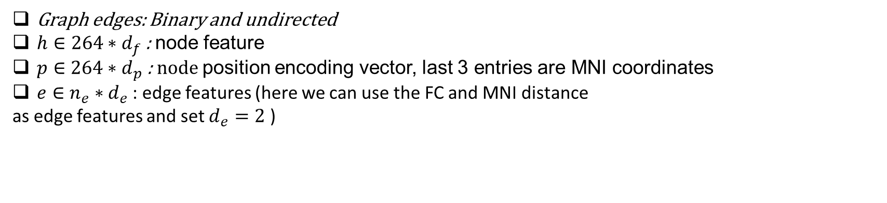
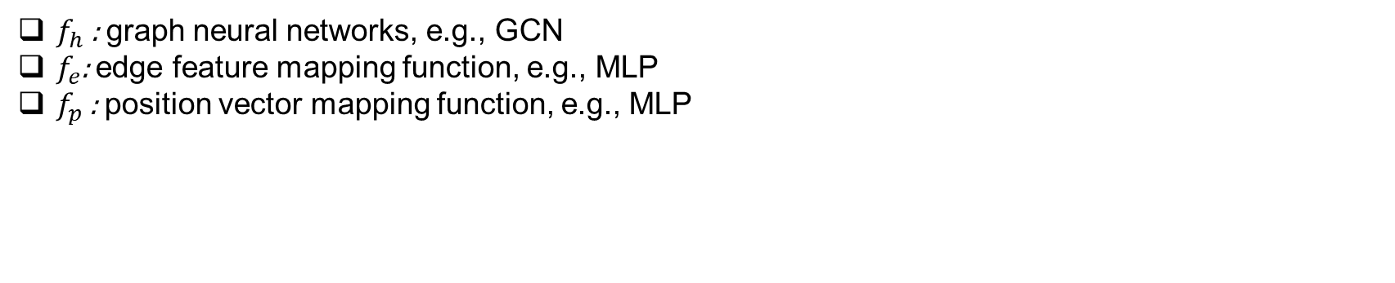
Graph edges: Binary and undirected
$h∈264∗d_{f}$ : node feature
$p∈264∗d_{p}$ : node position encoding vector, last 3 entries are MNI coordinates
$e∈n_{e}∗d_{e}$: edge features (here we can use the FC and MNI distance
as edge features and set $d_{e}=2$ )
Input
$f_{h}$ : graph neural networks, e.g., GCN
$f_{e}$: edge feature mapping function, e.g., MLP
$f_{p}$ : position vector mapping function, e.g., MLP
Learning parameters/ model

Slide 5
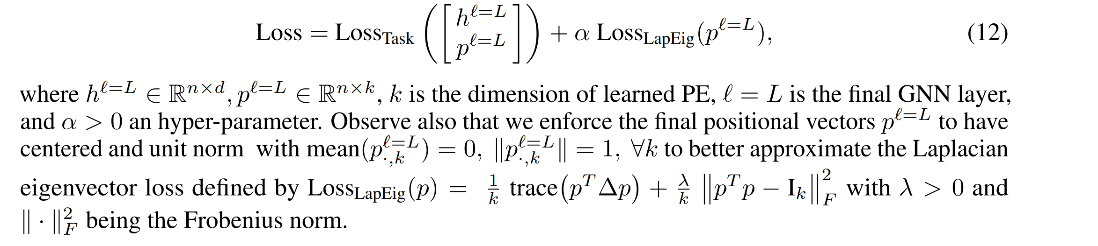

Position encoding
$p_{i}^{0}=\left[RW_{ii},RW_{ii}^{2}, ⋯,RW_{ii}^{k}, MNI_{x}, MNI_{y}, MNI_{z}\right]∈ℝ^{k+3}$, where $RW=AD^{−1}$
Loss function
*

Slide 6
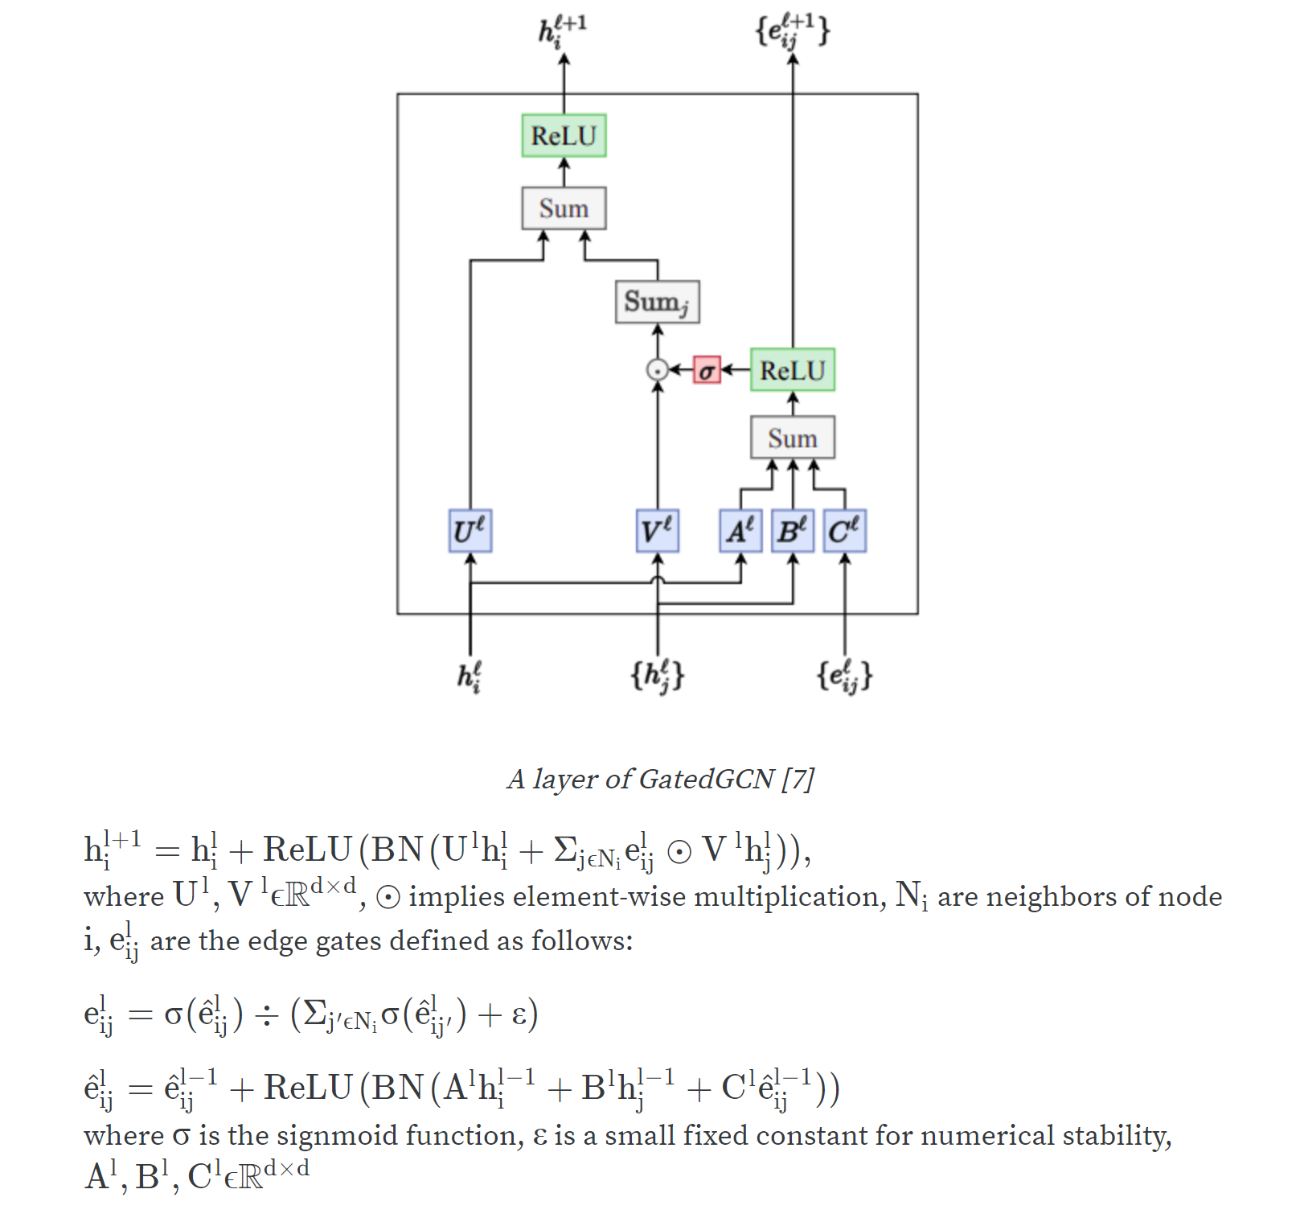
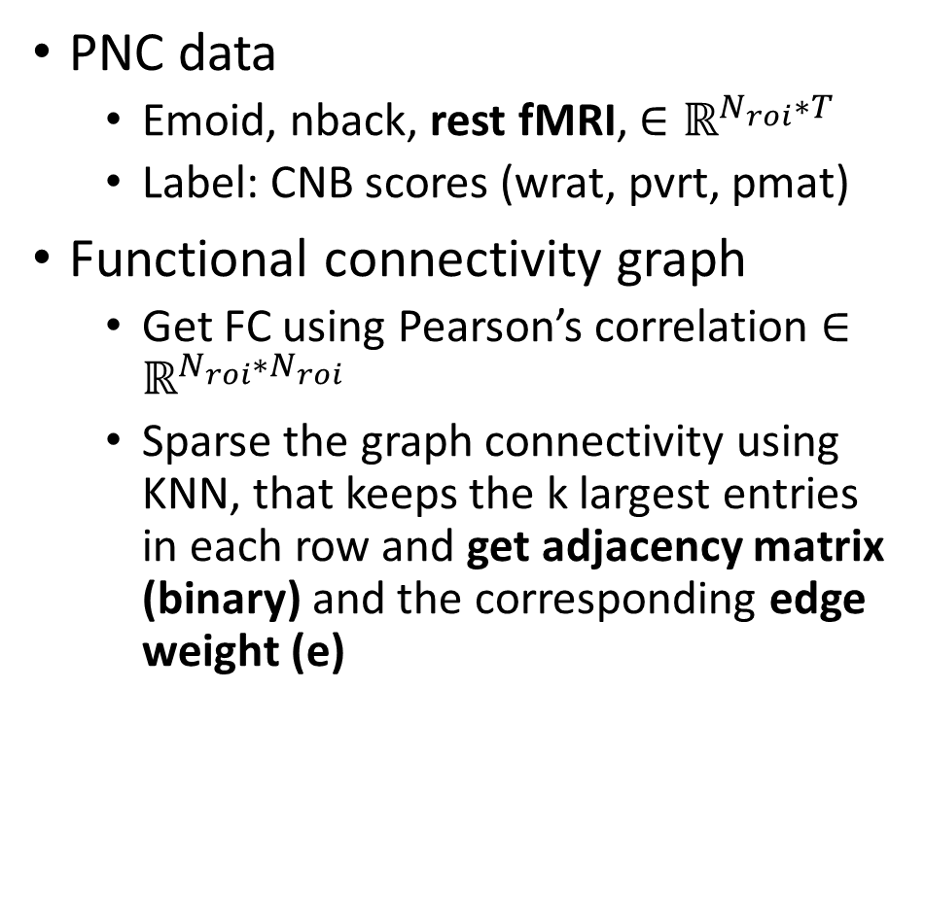
PNC data
Emoid, nback, rest fMRI, $∈ℝ^{N_{roi}∗T}$
Label: CNB scores (wrat, pvrt, pmat)
Functional connectivity graph
Get FC using Pearson’s correlation $∈ℝ^{N_{roi}∗N_{roi}}$
Sparse the graph connectivity using KNN, that keeps the k largest entries in each row and get adjacency matrix (binary) and the corresponding edge weight (e)
Gated GCN

Slide 7
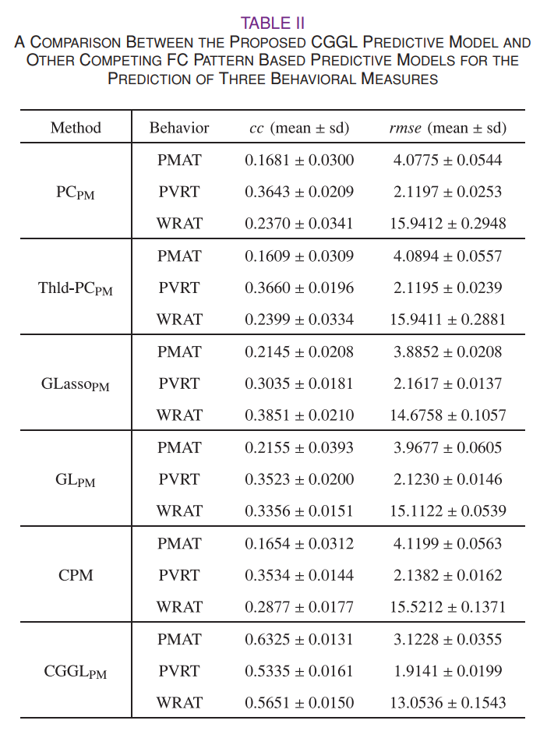
New preliminary results (regression)
Model | WRAT | PVRT | PMAT
MGCN (emoid+nback) | 14.0889 ± 0.7222 | - | -
GatedGCN (Rest fMRI) | 13.7728 (0.2744) | 2.1227 (0.0315) | 3.7113 (0.1056)
* Bootstrapping with 10 repeated experiments
Dr. Xiao excluded subjects below the age of 16 years and
only kept subjects between 16 to 22 years old

Slide 8
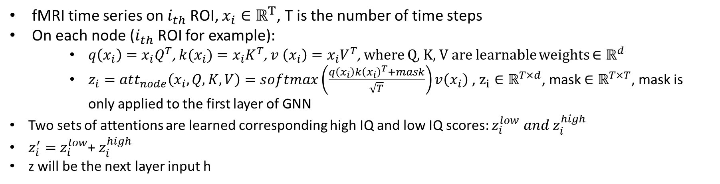
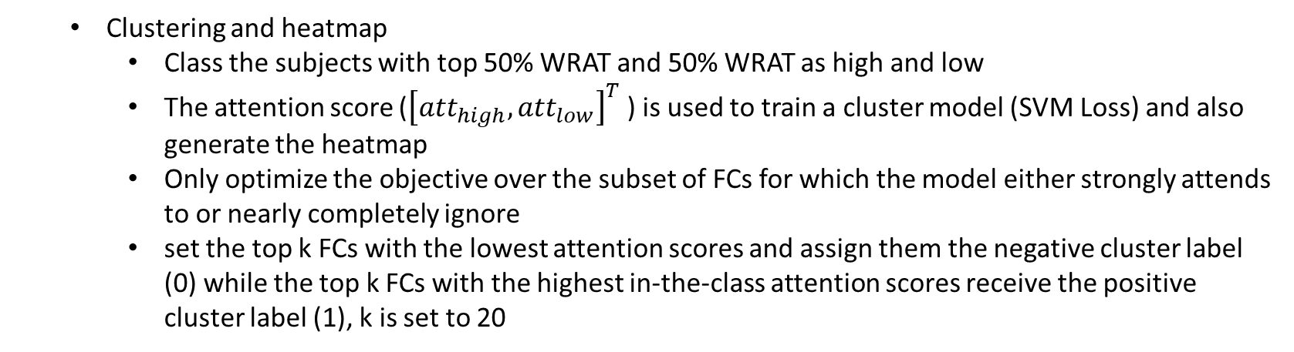
Attention layer and (Clustering layer)
fMRI time series on $i_{th}$ROI, $x_{i}∈ℝ^{T}$, T is the number of time steps
On each node ($i_{th}$ROI for example)$:$
$q\left(x_{i}\right)=x_{i}Q^{T}$,$k(x_{i})=x_{i}K^{T}$, $v \left(x_{i}\right)=x_{i}V^{T}$, where Q, K, V are learnable weights $∈ℝ^{d}$
$z_{i}=att_{node}\left(x_{i}, Q, K, V\right)=softmax\left(\frac{q\left(x_{i}\right)k{\left(x_{i}\right)}^{T}+mask}{\sqrt{T}}\right)v\left(x_{i}\right)$ , $z_{i}∈ℝ^{T×d}$, mask $∈ℝ^{T×T}$, mask is only applied to the first layer of GNN
Two sets of attentions are learned corresponding high IQ and low IQ scores: $z_{i}^{low} and z_{i}^{high}$
$z_{i}^{′}=$ $z_{i}^{low}$+ $z_{i}^{high}$
z will be the next layer input h
Clustering and heatmap
Class the subjects with top 50% WRAT and 50% WRAT as high and low
The attention score (${\left[att_{high}, att_{low}\right]}^{T}$) is used to train a cluster model (SVM Loss) and also generate the heatmap
Only optimize the objective over the subset of FCs for which the model either strongly attends to or nearly completely ignore
set the top k FCs with the lowest attention scores and assign them the negative cluster label (0) while the top k FCs with the highest in-the-class attention scores receive the positive cluster label (1), k is set to 20

Slide 9
T1
Subc vol
Cor thickness
Cor volume
Subcortical:
aseg(template name): brain volume
NAN-
cortical
DKTatlas: thickness, gray volume, surface Area
a2009s
Compare ROI:
Aparcaseg template

